Slide 1
ELECTRICAL SCIENCE-II (15B11EC211)
UNIT 1
LECTURE 3

Slide 2
Example 3
The single-pole double-throw switch S has been in position b for a long time so that the 5-μF capacitor is fully discharged. Now, at t = 0, the switch is thrown to position a. Determine
(a) v(0+),
(b) i(0+),
(c) time constant τ,
(d) v and i at t = 15 ms.

Slide 3
Solution :
(a)
Since the voltage across a capacitor cannot change instantaneously, we have v(0+) = v(0−) = 0 V
(b)
(c)
(d)
At t = 15 ms :

Slide 4
Single-Capacitor RC Circuit and Single-Inductor RL Circuit
The time constant for
For LR circuit,
For CR circuit,
Here, R_{Th} is Thevenin resistance as “seen” by the capacitor or inductor.

Slide 5
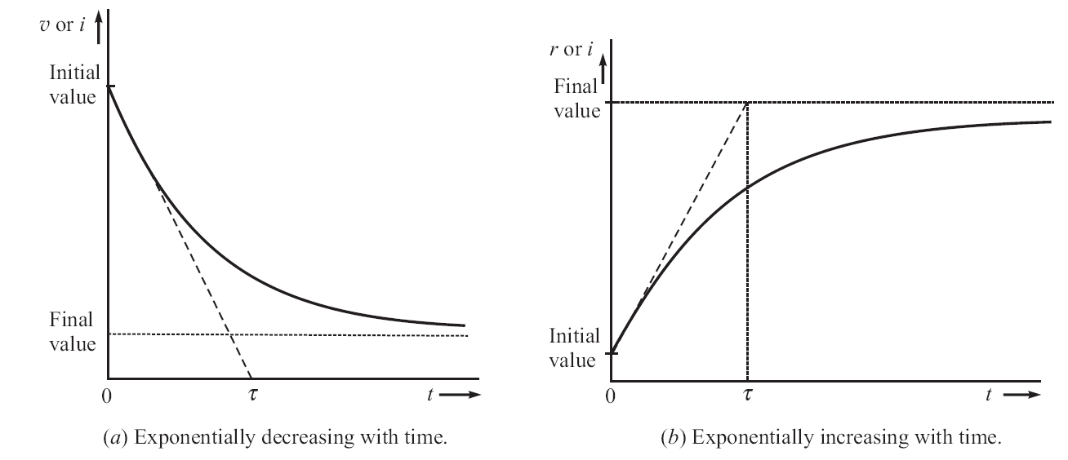

Slide 6
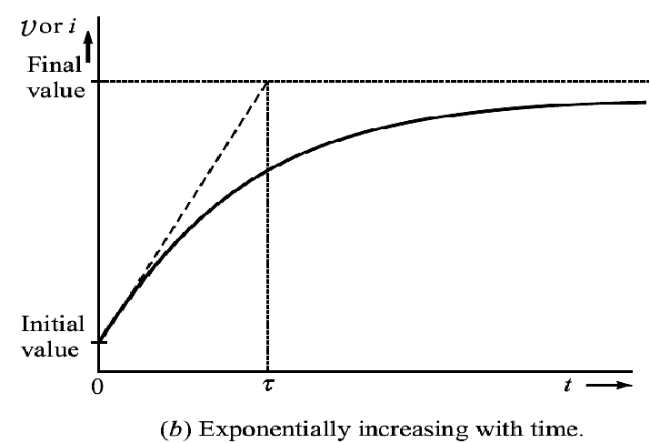

Slide 7
The voltages and currents approach their final values asymptotically.
It means that they never actually reach them.
However, after five time-constants they change by 99.3 % of their total change.

Slide 8
Important Point
(For solving Problems)
If immediately after switching,
v(0+) and i(0+) are initial values
and v(∞) and i(∞) are final values.
Then, the expressions for all the voltages and currents in the circuit for any time t are given as

Slide 9
Comparison between RC and RL Circuits
Though both give similar response, but we prefer RC over RL circuit, because
Inductors are not as nearly ideal as capacitors.
Inductors are relatively bulky, heavy and difficult to fabricate, especially using integrated-circuit techniques.
Inductors are relatively costlier.
The magnetic field emanating from the inductors can induce unwanted voltages in other components.

Slide 10
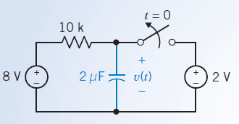
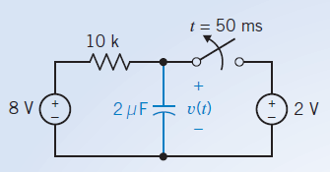
Unsolved Ques. 1: Find the capacitor voltage after the switch opens in the circuit shown in Figure below. What is the value of the capacitor voltage 50 ms after the switch opens?
Answer will remain same i.e. 7.51 volt
(a) (b)

Slide 11
Complete Solution by the Differential Equation Approach
5 major steps to find the complete solution:
Determine initial conditions on capacitor voltages and/or inductor currents.
Find the differential equation for either capacitor voltage or inductor current (mesh/loop/nodal …. analysis).
Determine the natural solution (complementary solution).
Determine the forced solution (particular solution).
Apply initial conditions to the complete solution to determine the unknown coefficients in the natural solution.

Slide 12



Here we will consider three cases for the input to the circuit.
First case
Second case
Third case
These three cases are special because the forced response will have the same form as the input.

Slide 13
References
R.C.Dorf and James A. Svoboda, “Introduction to Electric Circuits”,9thed, John Wiley & Sons, 2013.
Charles K. Alexander, Matthew N.O. Sadiku,“FundamentalsofElectricCircuits”, 6th Edition,Tata McGrawHill,2019.

